Slide 1


0/1 Knapsack Problem using Branch & Bound
Prepared By:-
Student 1 Name : Solanki Hardik Baldevbhai
Roll no : 36
Enrollment No : 22002170110183
Batch : A1 Branch : CE
Student 2 Name : Kateshiya Rahul Budhabhai
Roll no : 8
Enrollment No : 22002170110054
Batch : A1 Branch : CE
Student 3 Name : Jadeja Brijrajsinh Vanrajsinh
Roll no : 6
Enrollment No : 22002170110042
Batch : A1 Branch : CE
Student 4 Name : Chauhan Shruti
Roll no : 101
Enrollment No : 23002170220002
Batch : A3 Branch : IT
Student 5 Name : Rathod Diya Anilkumar
Roll no : 104
Enrollment No : 23002170220006
Batch : A3 Branch : IT

Slide 2
Project Outline :
Implement an efficient solution using Branch and Bound to reduce unnecessary computations and improve performance.
This approach is faster than brute force and ensures optimality compared to greedy heuristics.
Efficient solution with reduced computational complexity.
It is efficient, scalable, and widely applicable in real-world optimization problems.

Slide 3
Methodology :
STEP 1 : Problem Representation
-> Define n items, each with:
. Value [i] – profit of the item
. Weight [i] – Weight of the item
. W – Knapsack Capacity
STEP 2 : Implementing Branch and Bound
State Space Tree [ Represent each decision include/exclude an item]
Bounding Function [calculate upper bound]
Node Exploration [Max Heap]

Slide 4
STEP 3 : Algorithm Workflow
Sort item based on value/weight ratio.
Initialize root node with :
. Level = 0[first item],
. Total weight = 0,
. Total Value = 0,
. Upper-bound = V+(W-w)*(Wi+1/Vi+1)
iii. Use Best-First Search :
. Branch 1st – Include the item (update the Value & Weight).
. Branch 2nd – Exclude the item ( move to the next item).
. Explore the node with the highest bound first.
iv. Terminate : When all nodes are explored.

Slide 5
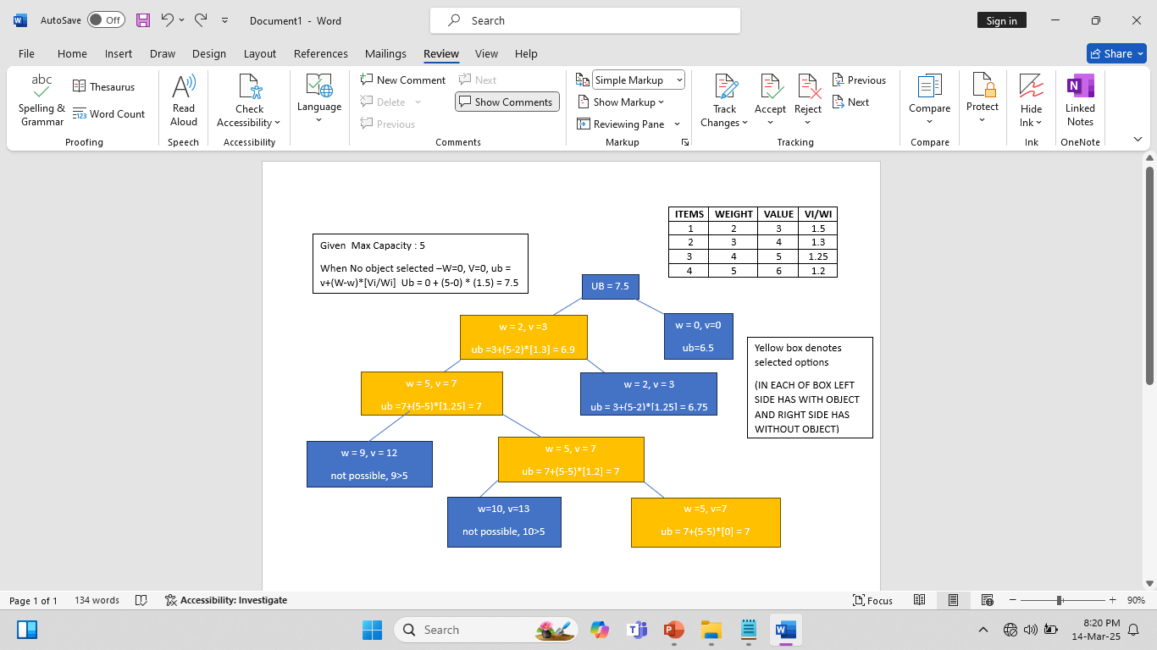
Implementation :

Slide 6
Future Enhancements and Applications :
Future Enhancements -
Implement Parallel processing for better efficiency.
Explore hybrid approaches combining Dynamic programming and Branch & Bound.
Apply Machine Learning for predictive bounding functions.
Applications -
Supply Chain Optimization.
Cargo Load Balancing.
Investment Portfolio Selection.
Project Selection for Maximum ROI(Return on Investment).

Slide 7
THANK YOU …

